Slide 1

PlantVillage
By
Mr.Abhinav Lugun
Mr.Md. Sakib Bin Alam
Mr.Pongraphe kangsanarak
Mr.Saw Lar Ka Paw
Mr.Paramik Dasgupta
Mr.Set Khaing Oo
CP for DSAI Project (August-22)

Slide 2
Presentation Outline
Motivation
About Dataset
Experiment
Extract, transform, load (ETL)
Exploratory data analysis (EDA)
Train, Val & Test Split
Creating CNN Models
Training CNN Models
Test/Inference
Examining Misclassified Labels
Transfer learning
Observation
Conclusion

Slide 3
Motivation
Plant disease detection can be a crucial work in the agriculture domain. Early stage symptom detection will increase the productivity of crops. By this study we used deep convolutional neural network and transfer learning for classifying plant diseases.

Slide 4
About Dataset
https://data.mendeley.com/datasets/tywbtsjrjv/1
Contains images of healthy leaves and many types of unhealthy leaves
has total class of 39
Dataset which we used were already augmented
image flipping
Gamma correction
noise injection
PCA color augmentation
rotation
scaling

Slide 5
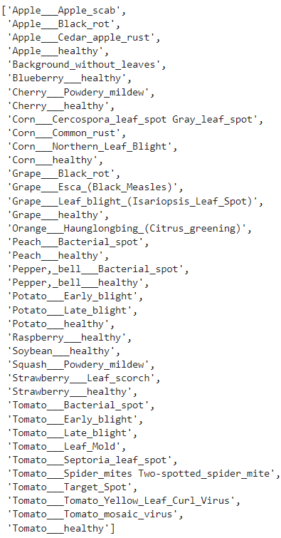
Classes in Dataset

Slide 6
Experiment
To see the effect of increasing the number of layers in CNN models on plant health identification
To see the effectiveness of transfer learning for this project

Slide 7
Extract, Transform, Load (ETL)

Slide 8
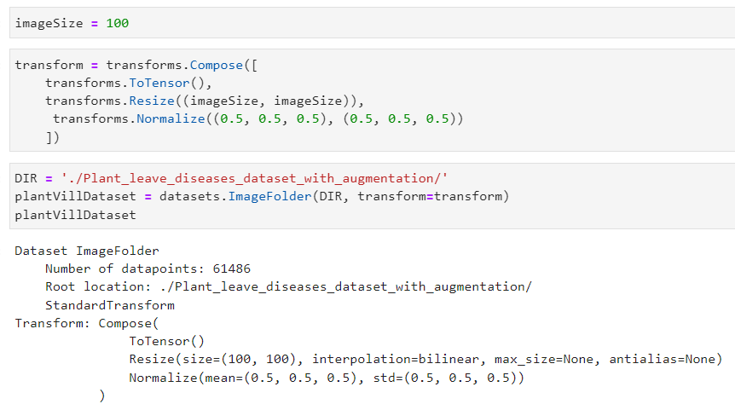
Extract, Transform, Load (ETL)

Slide 9
2) Exploratory Data Analysis (EDA)

Slide 10
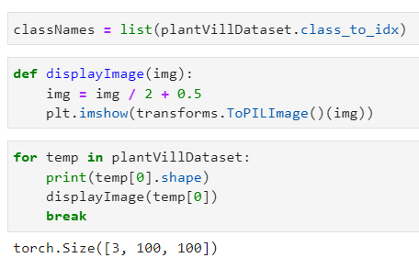
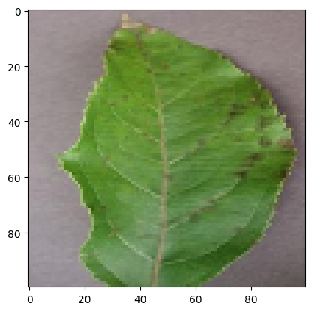
Exploratory data analysis (EDA)
Showing a sample image

Slide 11
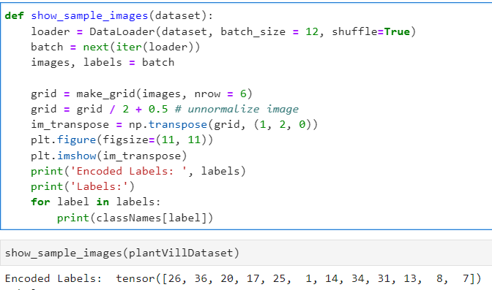
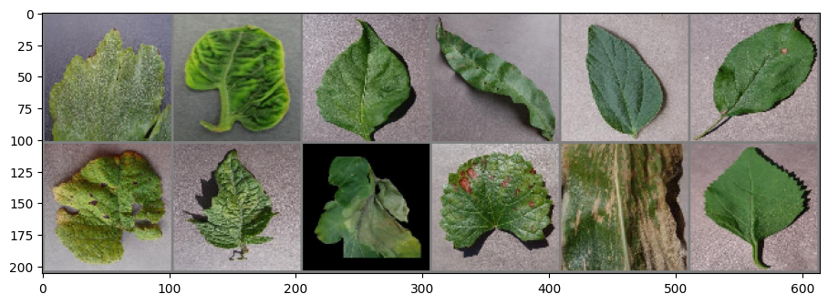
Showing images from different labels

Slide 12
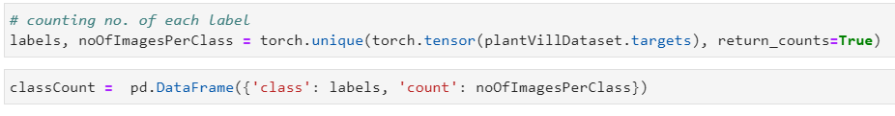
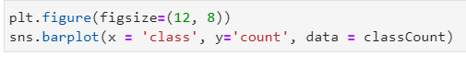
Check the balances of dataset

Slide 13
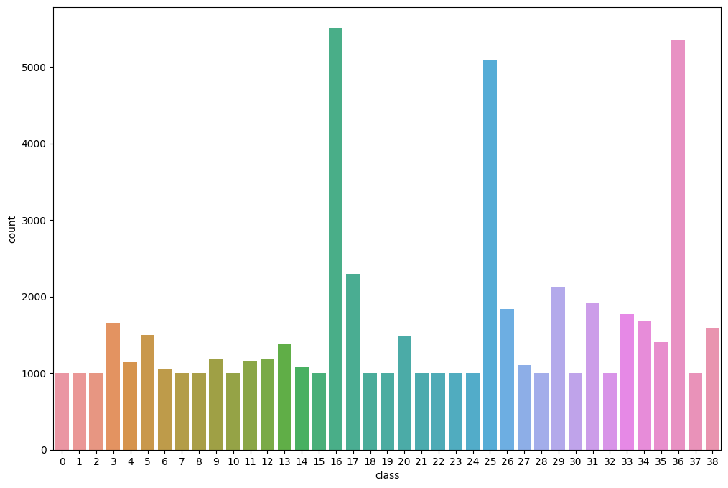
The dataset has a total of 39 classes.
Classes 16, 25, and 36 have much more samples than other classes making this an imbalanced dataset.

Slide 14
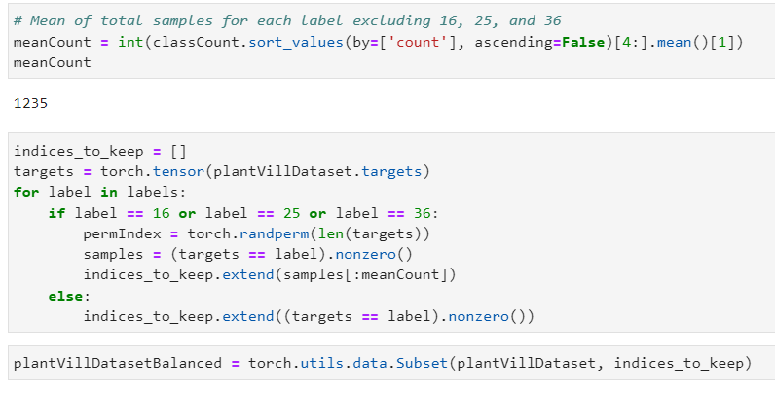
Reducing samples for label 16 25 36
https://discuss.pytorch.org/t/how-to-sample-images-belonging-to-particular-classes/43776/5

Slide 15
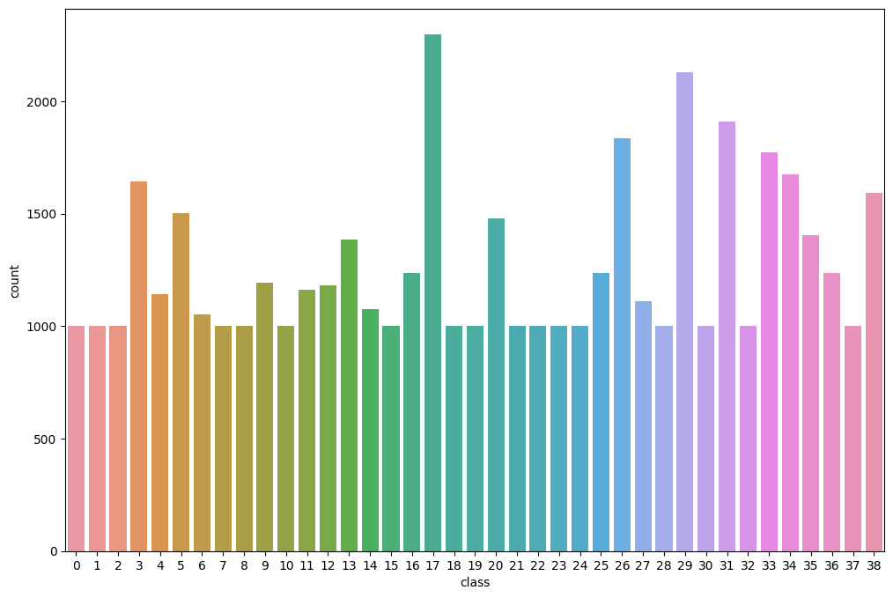
Result:
Classes are more balanced now

Slide 16
3) Train, Test, Val Split

Slide 17
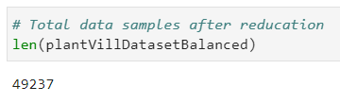
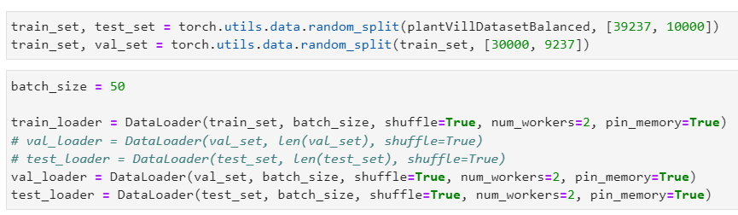
Train, Test, Val Split

Slide 18
4) Creating CNN Models

Slide 19
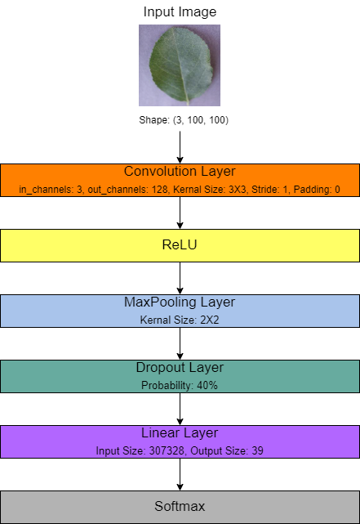
Creating CNN Models
Architecture of Model 1 :

Slide 20
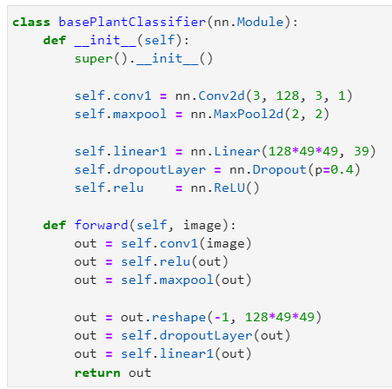
Creating CNN Models
Model 1: Base CNN Model

Slide 21
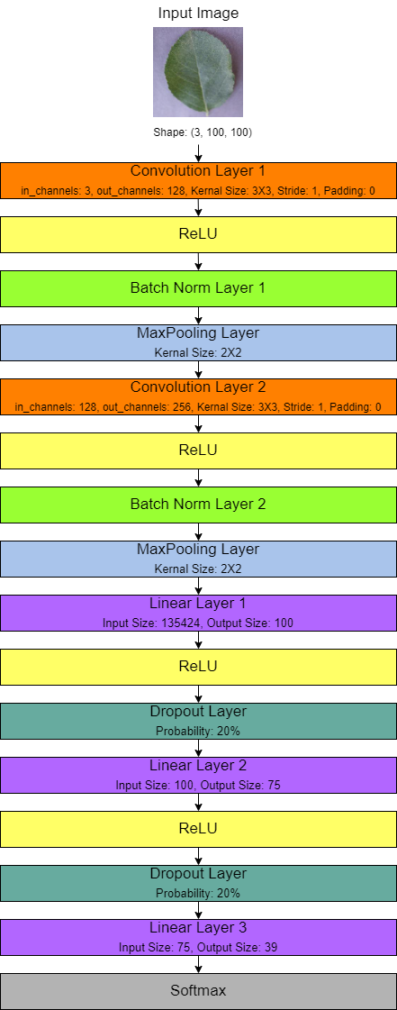
Creating CNN Models
Architecture of Model 2 :

Slide 22
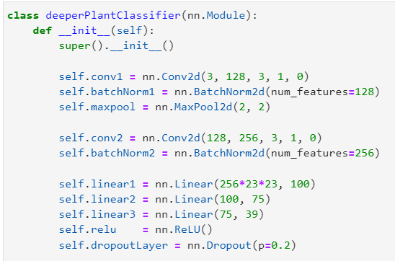
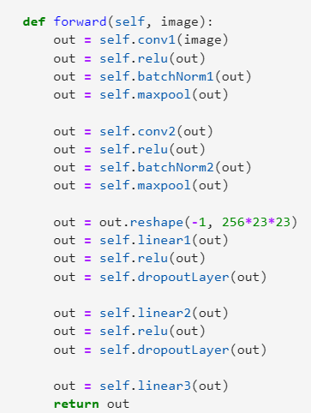
Creating CNN Models
Model 2: Deeper CNN Model

Slide 23
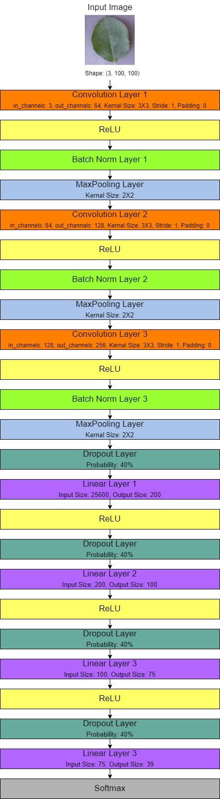
Creating CNN Models
Architecture of Model 3 :

Slide 24
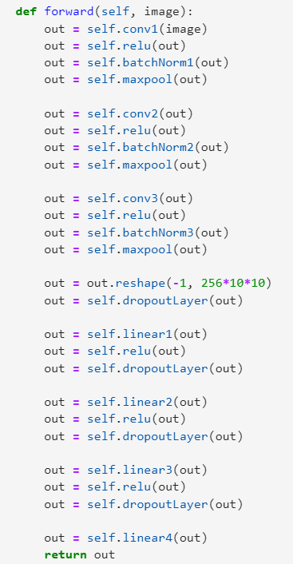
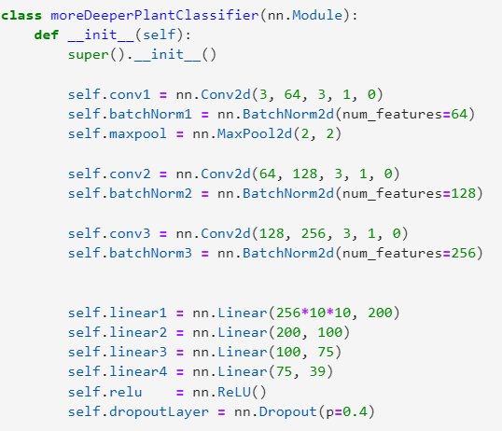
Creating CNN Models
Model 3: More Deeper CNN Model

Slide 25
Model Summary
 | Model 1 | Model 2 | Model 3
Total No. of Parameters | 11,989,415 | 13,852,559 | 5,522,551
Total No. of Layers | 2 | 5 | 7
Total No. of Conv. Layers | 1 | 2 | 3
Total No. of Linear Layers | 1 | 3 | 4

Slide 26
5) Training CNN Models

Slide 27
Training CNN Models
Basic Steps:
Predict Class
Calculate Loss
Update Training Weights
Repeat steps 1-3 until
until of epoch
early stopping due to overfitting
Validation:
Monitor model performance during training
For best val loss, model weights saved

Slide 28
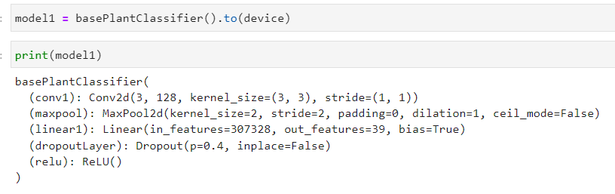
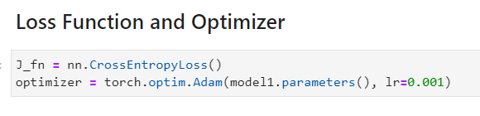
Train Model

Slide 29
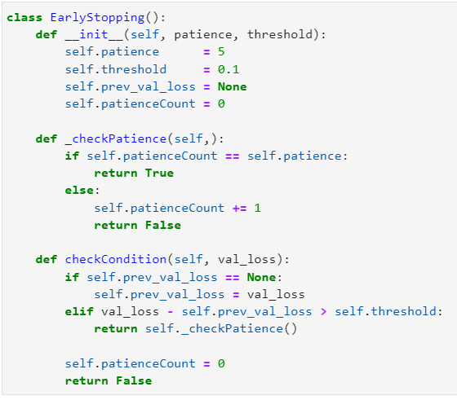
Train Model(cont…)

Slide 30
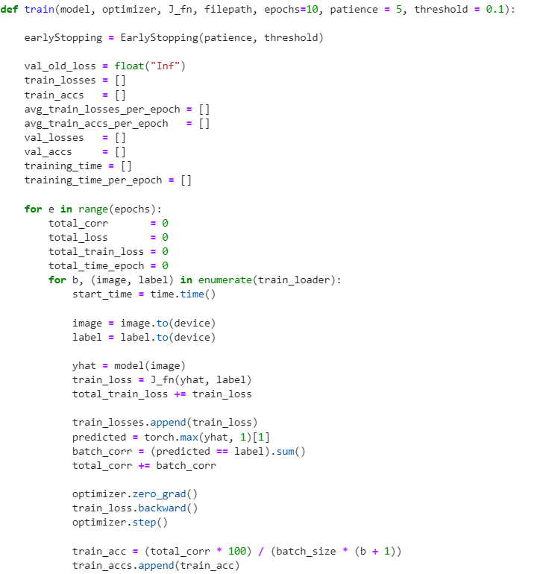
Train Model(cont…)

Slide 31
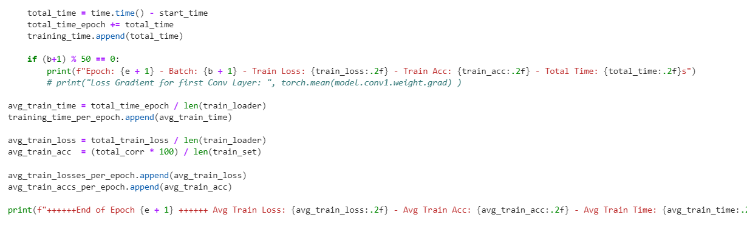
Train Model(cont…)

Slide 32
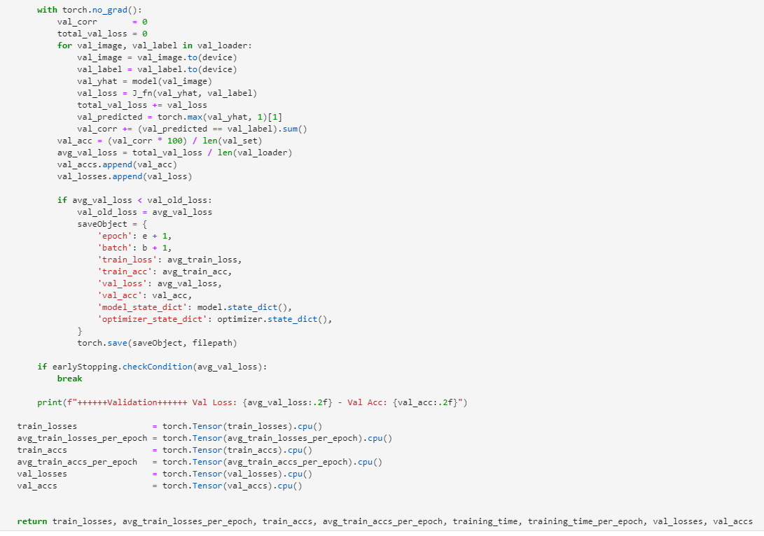
Train Model(cont…)

Slide 33
Training Observation
Model 1 and 3 overfitting early
Model 1 after 5 epochs
Model 3 after 15 epochs
Higher value of dropout used which helped significantly with overfitting issue

Slide 34
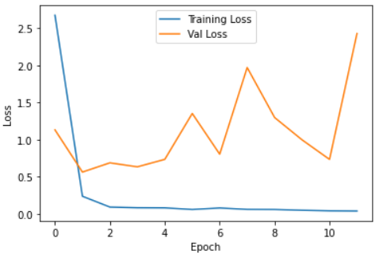
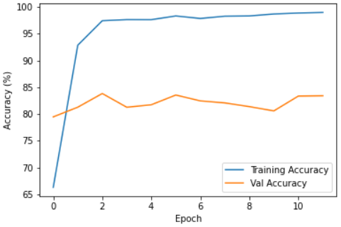
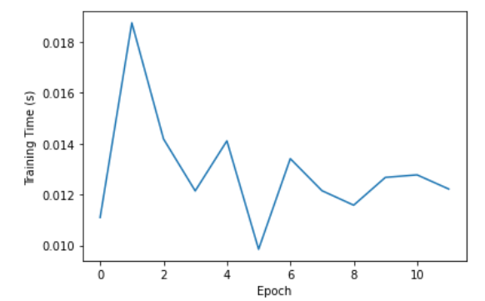
Plotting loss, accuracy and training time: Model 1
Accuracy Plot
Loss Plot
Training loss decreases rapidly
Validation loss increases quickly
Accuracy increases rapidly - network
is learning fast
Training stopped by earl stopping
callback
Training Time Plot

Slide 35
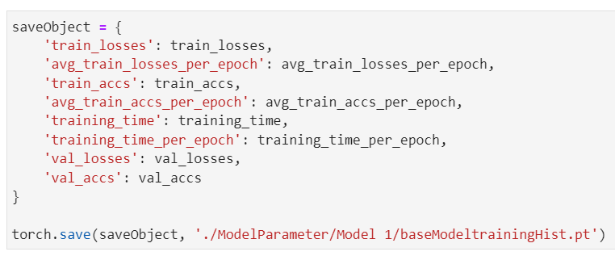
Plot Saved and Loaded

Slide 36
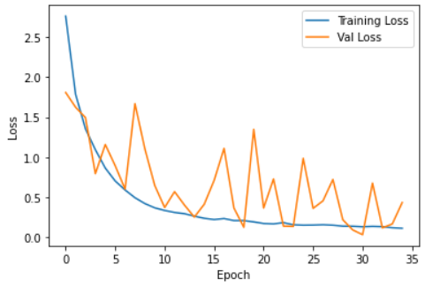
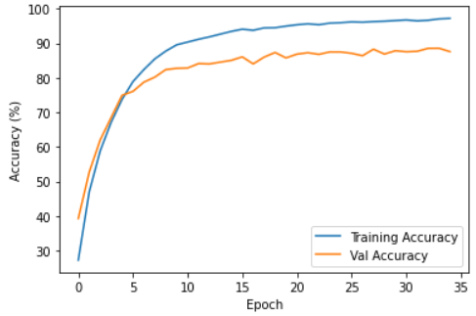
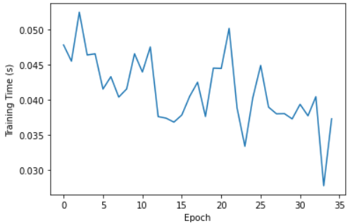
Plotting loss, accuracy and training time: Model 2
Accuracy Plot
Loss Plot
Training Time Plot
Validation loss increases
(but not very stably)
Validation accuracy rises too.

Slide 37
Plotting loss, accuracy and training time: Model 3
Accuracy Plot
Loss Plot
Training Time Plot

Slide 38
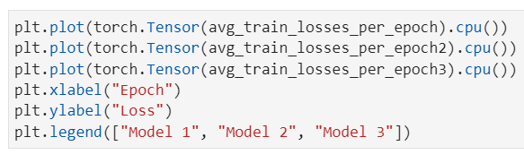
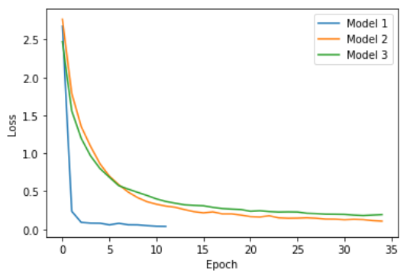
Compare 3 Models: Train loss
Train Loss

Slide 39
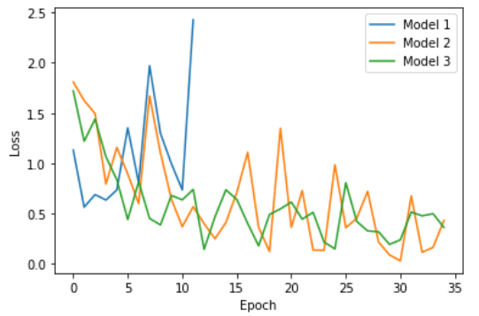
Compare 3 Models: Validation loss
Validation Loss

Slide 40
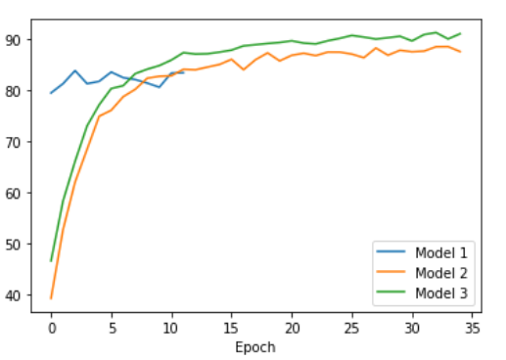
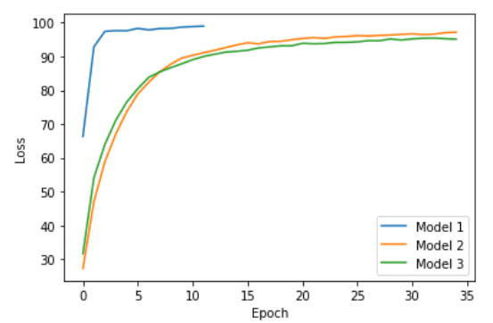
Compare 3 Models: Train accuracy and Validation accuracy
Training Accuracy
Validation Accuracy
Model 1 stop early
Good accuracy for training data.
Validation accuracy, model 3 perform the best
Training accuracy, model 2 perform the best

Slide 41
6) Testing/Inference

Slide 42
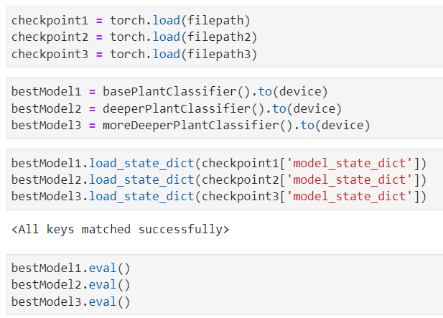
Test
Notes:
During the inference time, we load the weights from previously trained models and applied to their respective models. Then each model is set to evaluation mode.
drop out -> identity function

Slide 43
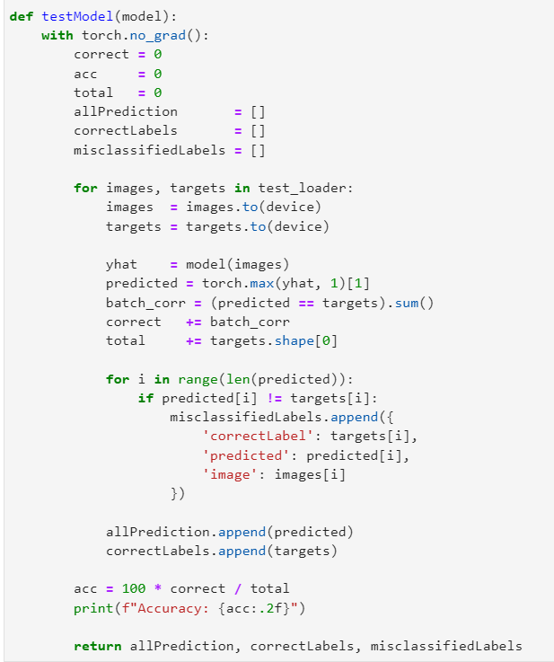
Test (cont…)
Notes:
In the test function, we first initialized the variables that are going to be used along with testing.
We set the correct predictions and accuracies to zero at first. We looped the testloader and pass the image tensor to the model in each iteration.
The predicted class for the image will be the maximum value from the output of the classifier.
The corrected predictions are sum up and then divided by the total length of the targets so that we got the accuracy .
The test function finally returns all the predictions, correct labels and misclassified labels.

Slide 44
Accuracy
Model | Accuracy
Model 1 | 84.14
Model 2 | 92.24
Model 3 | 96.66
Notes:
In comparison of the model performances, the testing accuracy for the third model has the highest score of 96.66% followed by 92% for model 2 and 84 for the first model.

Slide 45
Total Number of Misclassification
per Label
Model | Total Number of Misclassifications per Label
Model 1 | 1586
Model 2 | 776
Model 3 | 334
Notes:
Consequently, the model3 performance is the best, therefore, we got the least misclassified labels for the model 3. The rest two models have relatively higher misclassifications which have 1586 and 776 respectively.

Slide 46
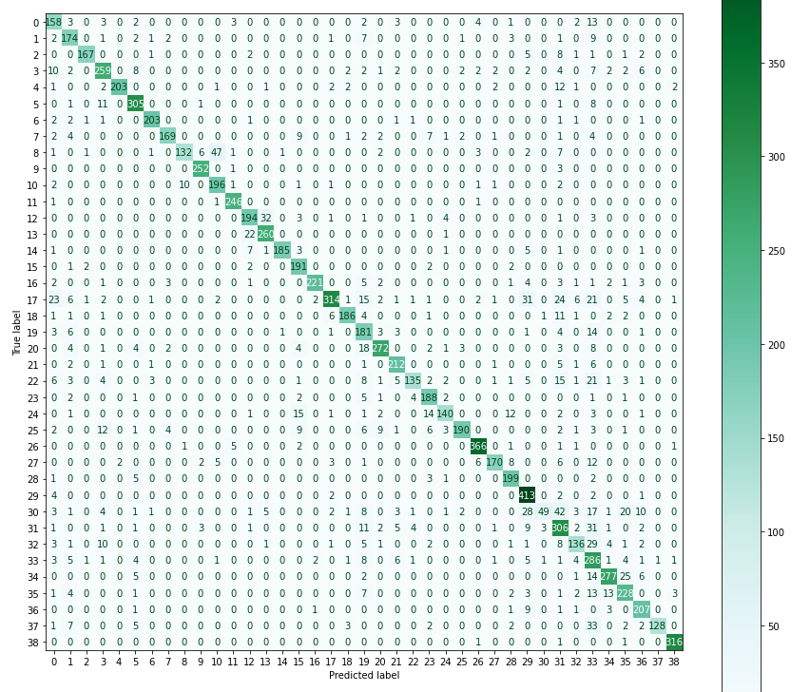
Confusion Matrix: Model 1
Notes:
the confusion matrix are plotted for each model. we have predicted labels on x axis plotted against the ground truth on the y axis. For example, class number 30 is poorly classified total around 156 -> only 49 is correctly classified
34+29+42+3+17+1+30

Slide 47
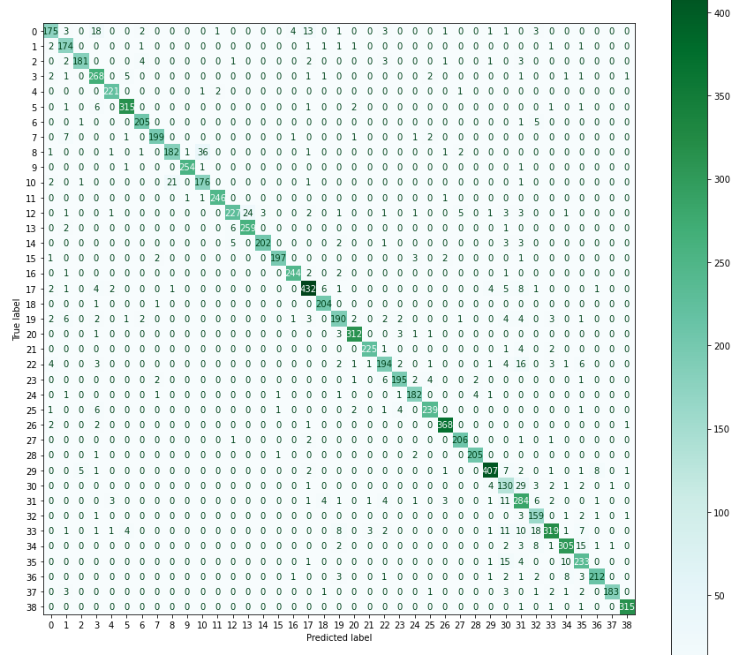
Confusion Matrix: Model 2

Slide 48
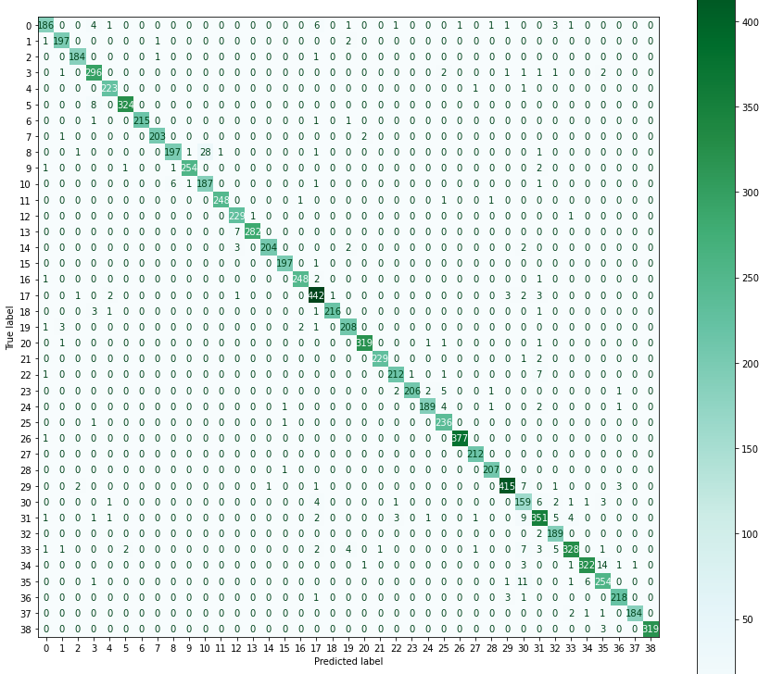
Confusion Matrix: Model 3

Slide 49
6.1) Examine misclassified images

Slide 50
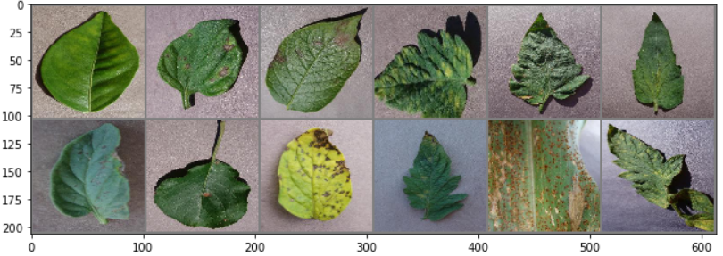
Examine misclassified images: Model 1
Showing few misclassified images

Slide 51
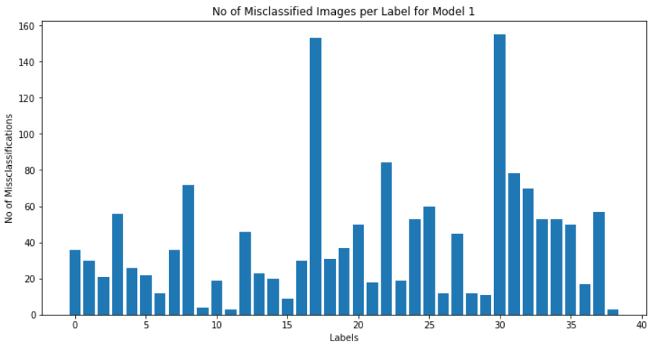
No of misclassified images per label for Model 1

Slide 52
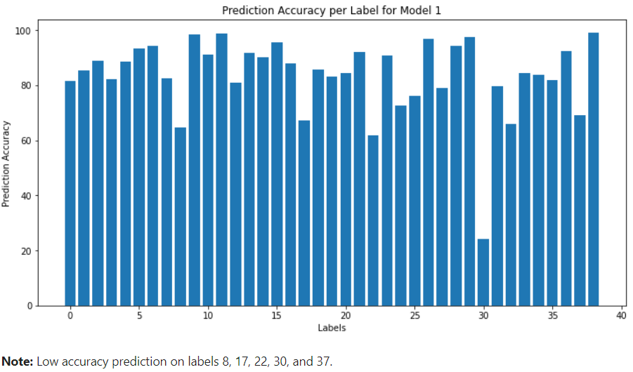
Prediction accuracy per label for Model 1

Slide 53
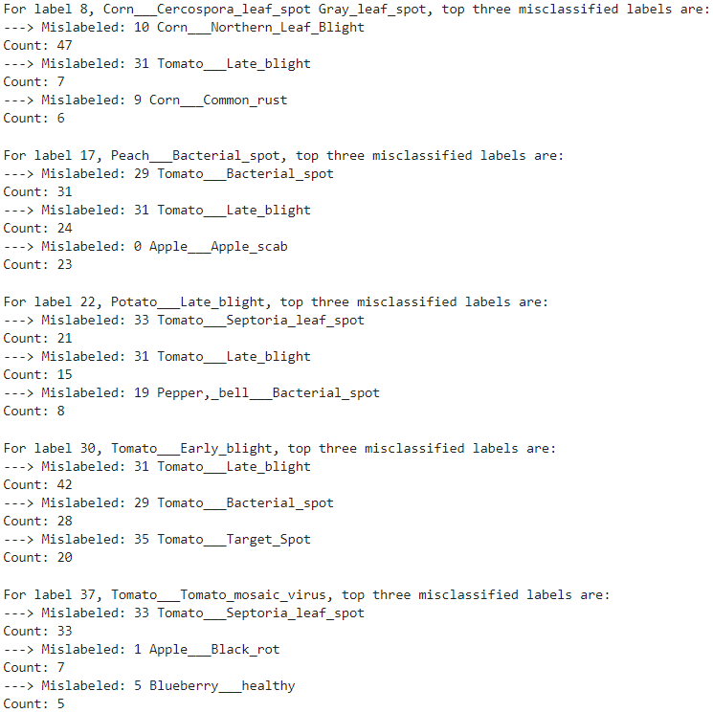
Top 3 mislabelled count: Model 1

Slide 54
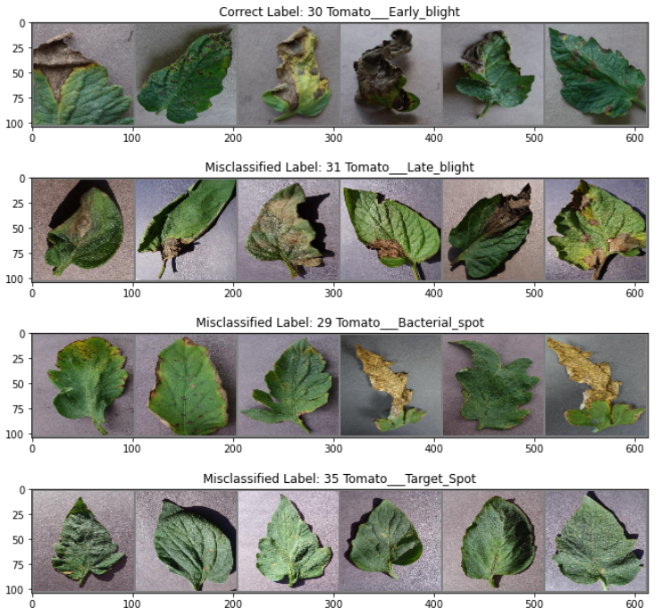
Showing some misclassified images for label 30

Slide 55
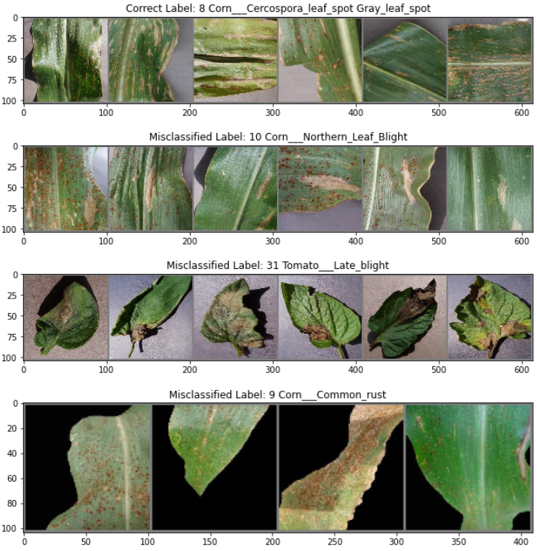
Showing some misclassified images for label 8

Slide 56

Showing some misclassified images for label 22

Slide 57

Examine misclassified images: Model 2
Showing few misclassified images

Slide 58

No of misclassified images per label for Model 2

Slide 59

Prediction accuracy per label for Model 2

Slide 60

Top 3 mislabelled count: Model 2

Slide 61

Showing some misclassified images for label 0

Slide 62

Showing some misclassified images for label 30

Slide 63

Examine misclassified images: Model 3
Showing few misclassified images

Slide 64

No of misclassified images per label for Model 3

Slide 65

Prediction accuracy per label for Model 3

Slide 66

Top 3 mislabelled count: Model 3

Slide 67

Showing some misclassified images for label 8

Slide 68
Result Summary
 | Model 1 | Model 2 | Model 3
Number of Layers | 2 | 5 | 7
Accuracy | 84.14 | 92.24 | 96.66
Total Misclassifications | 1586 | 776 | 334

Slide 69
7) Transfer Learning

Slide 70


Transfer Learning: Alexnet

Slide 71



Plotting loss, accuracy and training time: Alexnet
Accuracy Plot
Loss Plot
Training Time Plot

Slide 72

Transfer Learning: Resnet

Slide 73
Plotting loss, accuracy and training time: Resnet
Accuracy Plot
Loss Plot
Training Time Plot

Slide 74
8) Testing/Inference

Slide 75
Accuracy on test data
Model | Accuracy
Alexnet | 85.02
Resnet | 88.35

Slide 76
Total Number of Misclassification
per Label
Model | Total Number of Misclassifications per Label
Alexnet | 1498
Resnet | 1165

Slide 77

Confusion Matrix: Alexnet

Slide 78

Confusion Matrix: Resnet

Slide 79
8.1) Examine misclassified images

Slide 80

No of misclassified images per label for Alexnet
Total misclassified images: 1498

Slide 81

Prediction accuracy per label for Alexnet

Slide 82

Top 3 mislabelled count: Alexnet

Slide 83

Showing some misclassified images for label 30

Slide 84

Showing some misclassified images for label 0

Slide 85

Showing some misclassified images for label 32

Slide 86

No of misclassified images per label for Resnet
Total misclassified images: 1165

Slide 87

Prediction accuracy per label for Resnet

Slide 88
Top 3 mislabelled count: Resnet

Slide 89

Showing some misclassified images for label 30

Slide 90

Showing some misclassified images for label 32

Slide 91

Showing some misclassified images for label 35

Slide 92
Overall Comparison in terms of Accuracy
Model | Accuracy
Model 1 | 84.14
Model 2 | 92.24
Model 3 | 96.66
Alexnet | 85.02
Resnet | 88.35

Slide 93
Overall Comparison in terms of number of
image misclassification
Model | Total Number of Image Misclassifications
Model 1 | 1587
Model 2 | 776
Model 3 | 334
Alexnet | 1498
Resnet | 1165

Slide 94
Observation
Increasing number of layers tend to improve model accuracy
However, it can also increase chances for model to overfit early
Can be mitigated with dropout to some extent
Transfer learning models perform better than only model 1
original trained on 224X224 image size
Learned features were useful but need further training

Slide 95
Observation
Good number of misclassifications seem to be related with tomato leaves
E.g.
Model 1 had low accuracy on
Tomato___Early_blight
Tomato___Tomato_mosaic_virus
Model 2 had low accuracy
Tomato___Early_blight
Alex had low accuracy on
Tomato___Early_blight
Tomato___Leaf_Mold
Tomato___Target_Spot

Slide 96
Observation
Resnet had low accuracy on
Tomato___Early_blight
Tomato___Late_blight
Tomato___Leaf_Mold
Tomato___Target_Spot
Model 1 misclassified Peach__Bacrial_spot with
Tomato__Bacterial
Model 2 misclassified Corn___Cercospora_leaf_spot Gray_leaf_spot with
Tomato___Late_blight

Slide 97
Observation
Resnet had low accuracy on
Tomato___Early_blight
Tomato___Late_blight
Tomato___Leaf_Mold
Tomato___Target_Spot
Model 1 misclassified Peach__Bacrial_spot with
Tomato__Bacterial
Model 2 misclassified Corn___Cercospora_leaf_spot Gray_leaf_spot with
Tomato___Late_blight

Slide 98
Observation
Good number of misclassifications of and with also came from apple, corn, and peach but not as much as tomato leaves

Slide 99

Observation
Model 1

Slide 100
Observation
Model 1

Slide 101

Observation
Model 2
Alexnet

Slide 102
Conclusion
Having a deep CNN architecture can give a very good results
This is supported by pre-trained models where Resnet, having much more layers, performed better than Alexnet

Slide 103


Logistic Regression
Input layer
Logistic: Linear Function
SoftMax Function
Labels: Cross Entropy function
Parameter: 1,170,039
Layer : (Linear)1
Best Accuracy: 60%
Rerun for 3 times to get the accuracy

Slide 104
Pros & Cons on Models
Pros
CNN able to detects features without Human to supervised
CNN can do no worse than Logistic because of number of layer. The more layer, the more learning capability.
Logistic Regression easy to implement than CNN model
Cons
CNN use a lot of data to train so image size is needed to be reduce due to Hardware’s Capability
Logistic Regression need to have a lot more of epoch to get the best accuracy

Slide 105
Future Work
It is yet to be seen how well these models generalize on the real data generated by the potential users. Therefore, it would be the next step to test our model in some real world data, may be produced by the ministry of agriculture of any country.

Slide 106
References
Mohanty, S. P., Hughes, D. P., & Salathé, M. (2016). Using deep learning for image-based plant disease detection. Frontiers in plant science, 7, 1419.
Esgario, J. G., Krohling, R. A., & Ventura, J. A. (2020). Deep learning for classification and severity estimation of coffee leaf biotic stress. Computers and Electronics in Agriculture, 169, 105162.
Antonio Bruno, Davide Moroni, & Riccardo Dainelli (2022) Improving plant disease classification by adaptive minimal ensembling. Frontiers in Artificial Intelligence. 10.3389/frai.2022.868926

Slide 107
Thank you!

